Slide 1
How to Create a Hi Korea Account

Slide 2
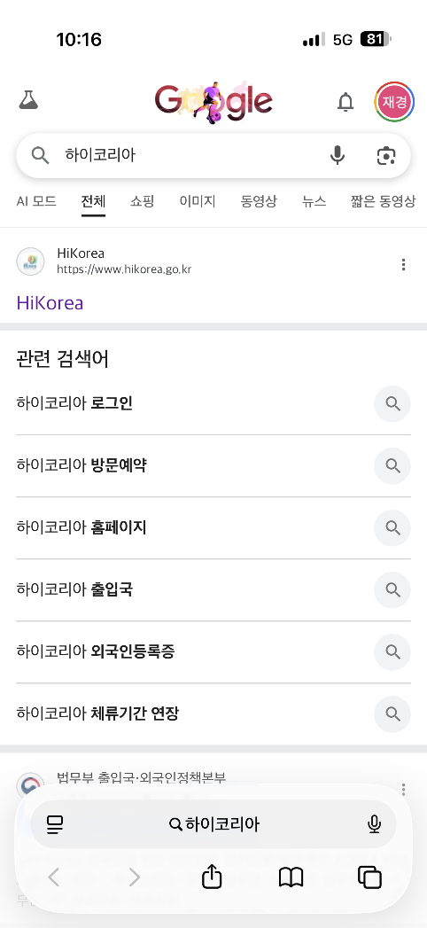
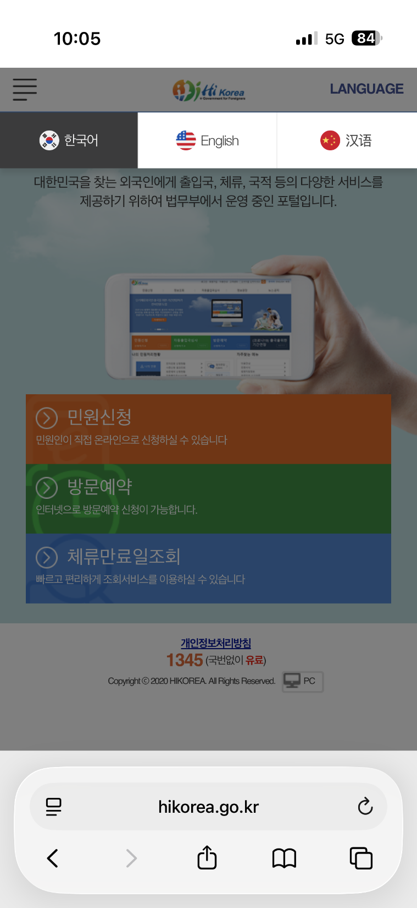
1. Search for "Hi Korea" online.
2. Select your preferred language (Korean or English) on the main page.

Slide 3
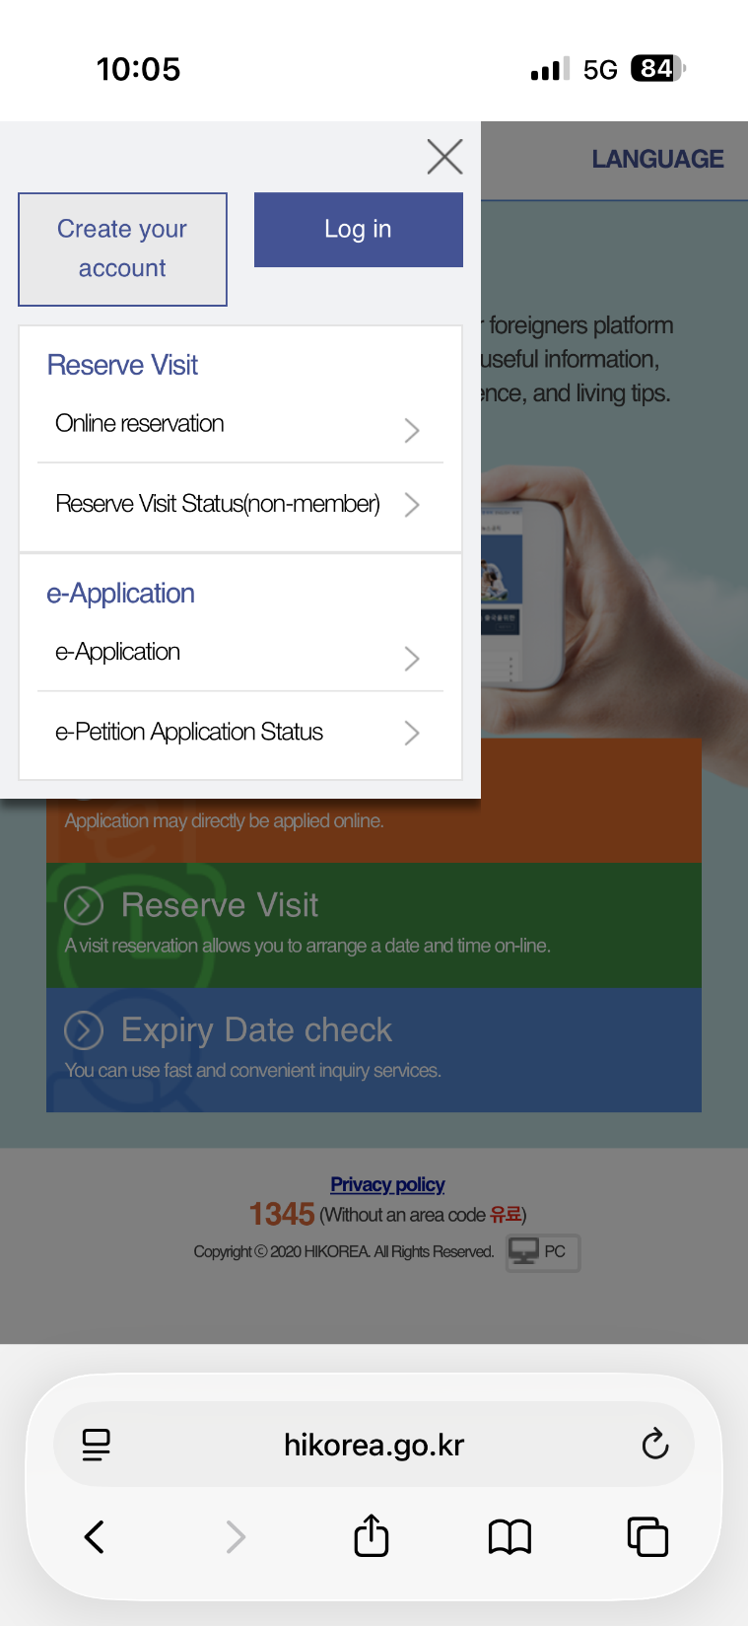
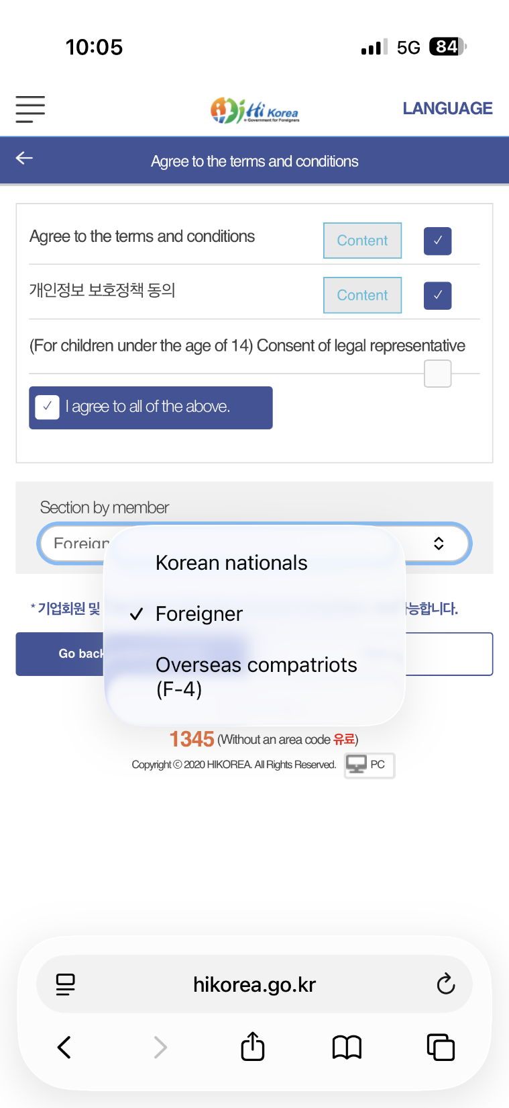
1. Tap the Menu icon (three lines) at the top left, , then select "Create your account."
2. Agree to all terms and select "Foreigner" under Section by member.

Slide 4
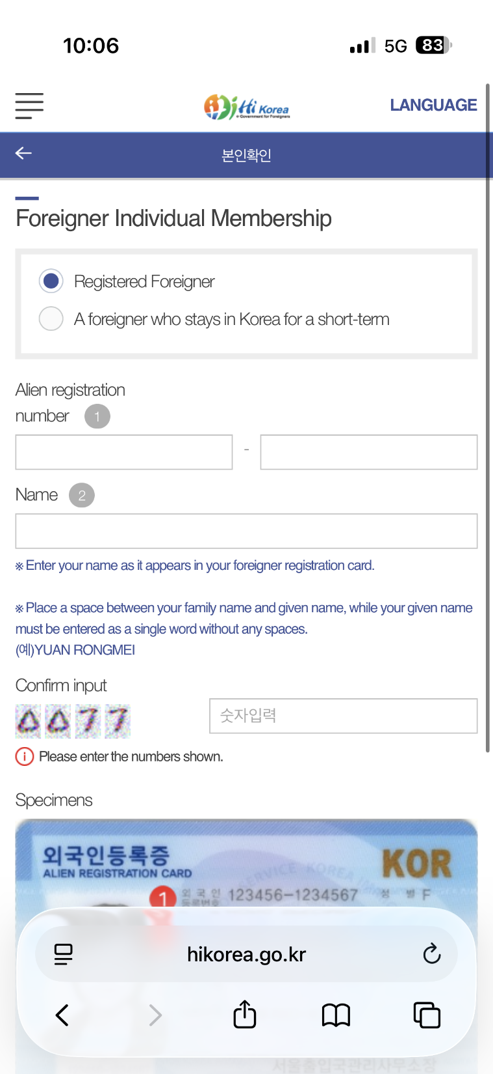
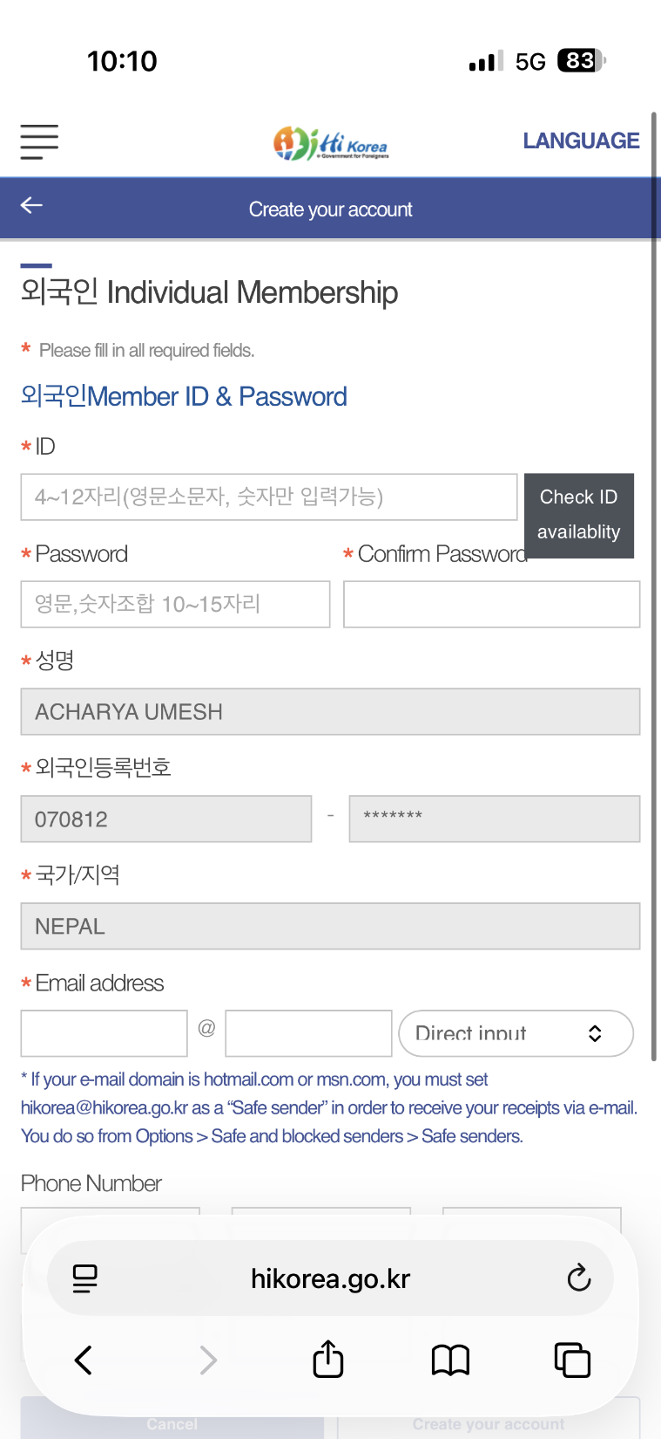
1. Enter your Alien Registration Number and Full Name exactly as they appear on your Residence Card (ARC).
2. Create your own ID. For the password, use hyupsung@[last 4 digits of your student ID]
Example: If your student ID is 20261234, your password will be hyupsung@1234
3. Enter your email and phone number to complete your account creation.
※ Important: Once completed, you should submit your ID and password to our office (via KakaoTalk or by visiting us in person).

Slide 5
Why Do You Need a Hi Korea Account?
1. No Reservation = No Entry: Immigration offices strictly require online reservations for visits.
2. Address Change (Within 14 Days): Update your residence online within 2 weeks when you move to a new place to stay.
3. Part-time Work Permit: Apply for your part-time work online.
To save time, students who have made a reservation through HiKorea are encouraged to visit the Immigration Office in person and submit the required documents for a part-time work permit.
The permit may be approved and issued on the same day during the visit.

