Slide 1

How to check your grade
1st semester
Global Affairs & Education

Slide 2
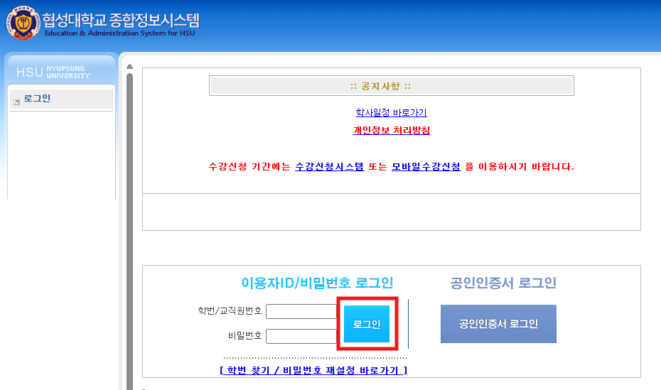
Website(https://hiis.uhs.ac.kr/) login
How to Check International Students' Grades
ID: Stuedent ID number
PW: DOB(8 digits)

Slide 3
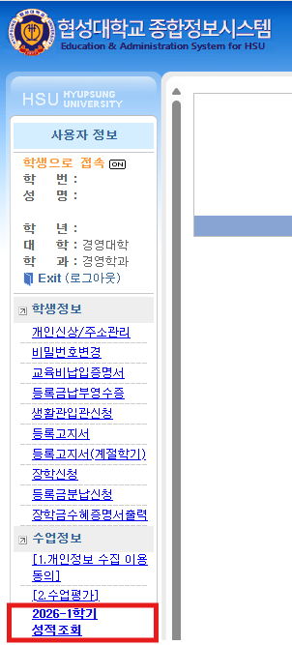
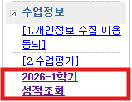
2. ‘2026-1학기 성적 조회’ Click
How to Check International Students' Grades

Slide 4
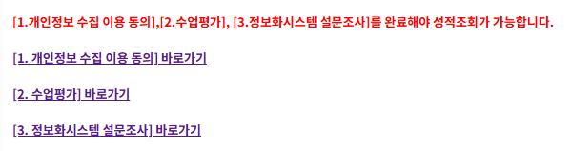
3. Survey participation
(you must complete all surveys 1, 2, and 3 to be able to check your grades)
How to Check International Students' Grades

Slide 5
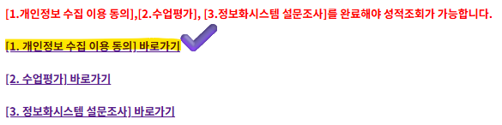
1. [개인정보 수집 및 제공 이용에 대한 동의] Click
How to Check International Students' Grades

Slide 6
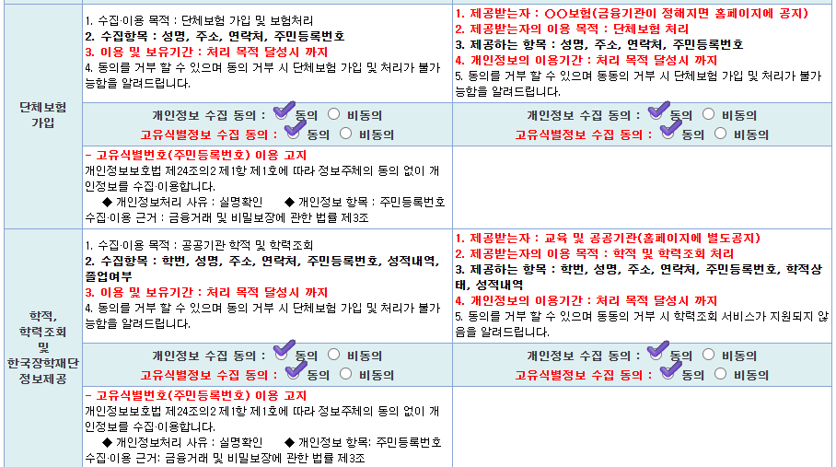
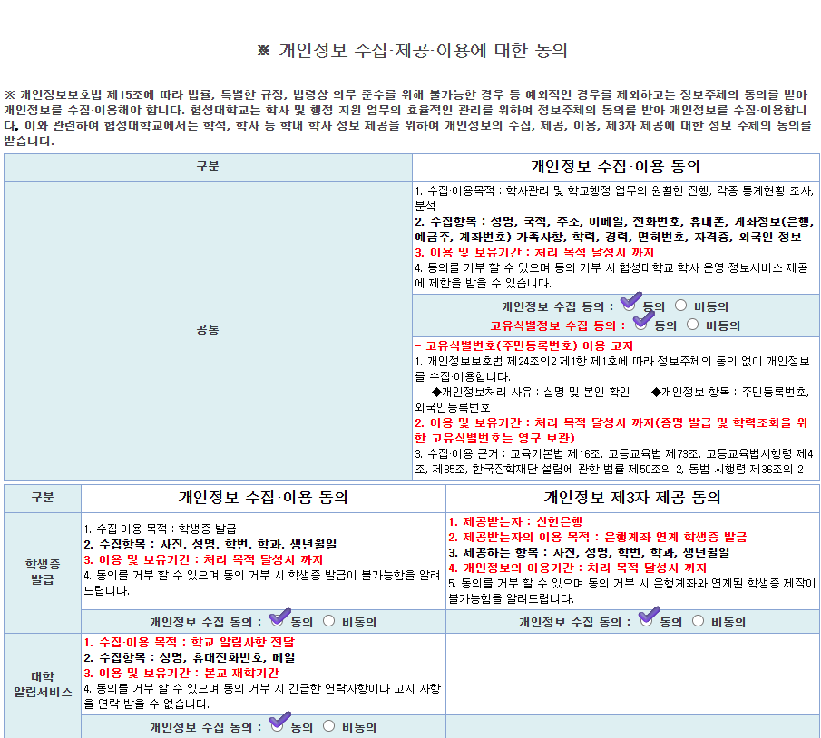
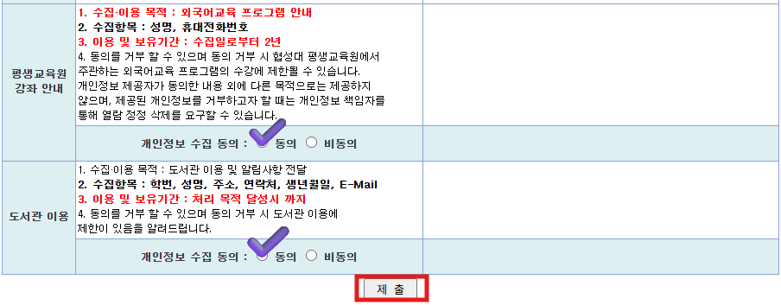
1-1. You need to select 'Agree to all’.
※ Make sure to click the '제출' (Submit) button at the bottom.
How to Check International Students' Grades

Slide 7
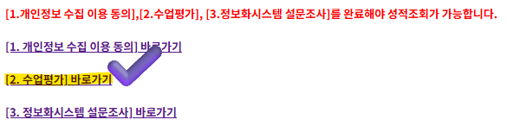
2.[수업평가] 바로가기 Click
How to Check International Students' Grades

Slide 8
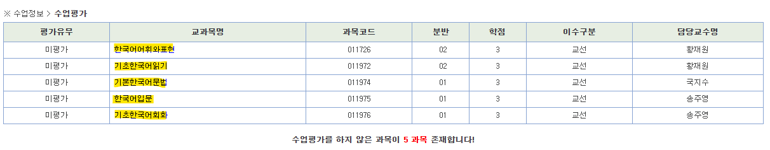
2-1. Click on each course name to complete the course evaluation survey for all classes.
How to Check International Students' Grades

Slide 9
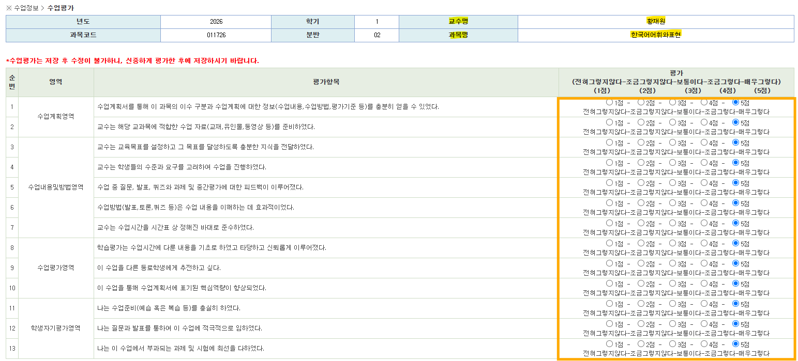
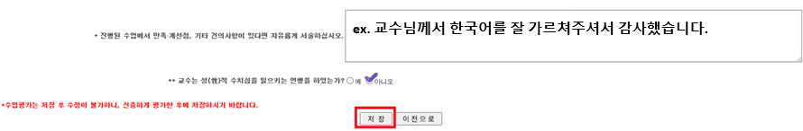
2-2. Please check the appropriate items.
(please follow the photo)
How to Check International Students' Grades
※ Make sure to click '저장'(SAVE) at the end.

Slide 10
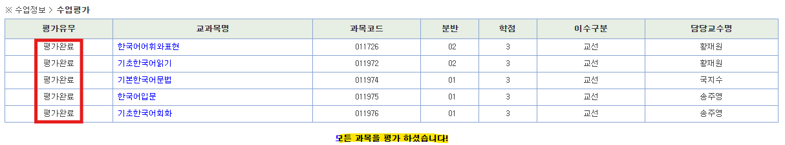
2-3. Once you complete the survey for all classes, it will change to '평가완료' (Evaluation Complete) as shown in the photo.
How to Check International Students' Grades

Slide 11
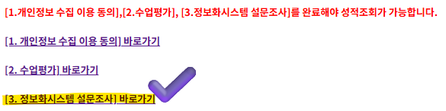
3. [정보화시스템 설문조사] Click
How to Check International Students' Grades

Slide 12
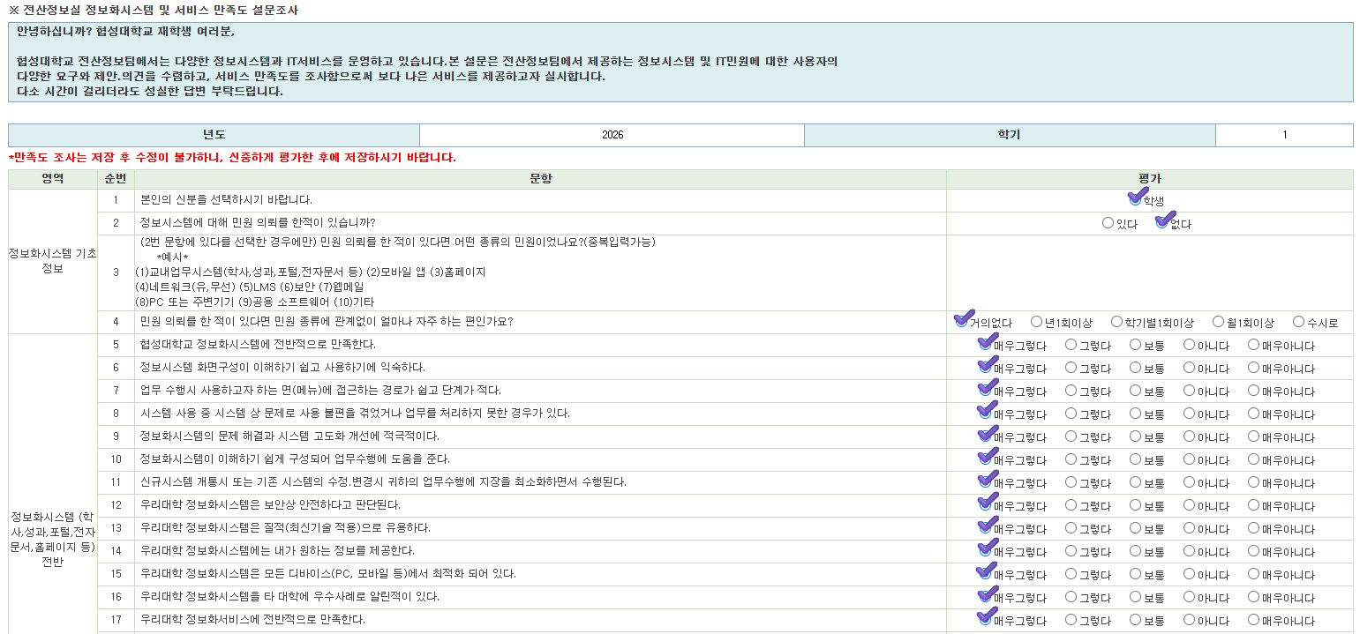
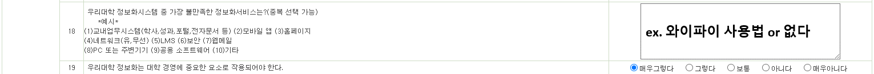
3-1. Please check the items exactly as shown in the photo below.
How to Check International Students' Grades

Slide 13
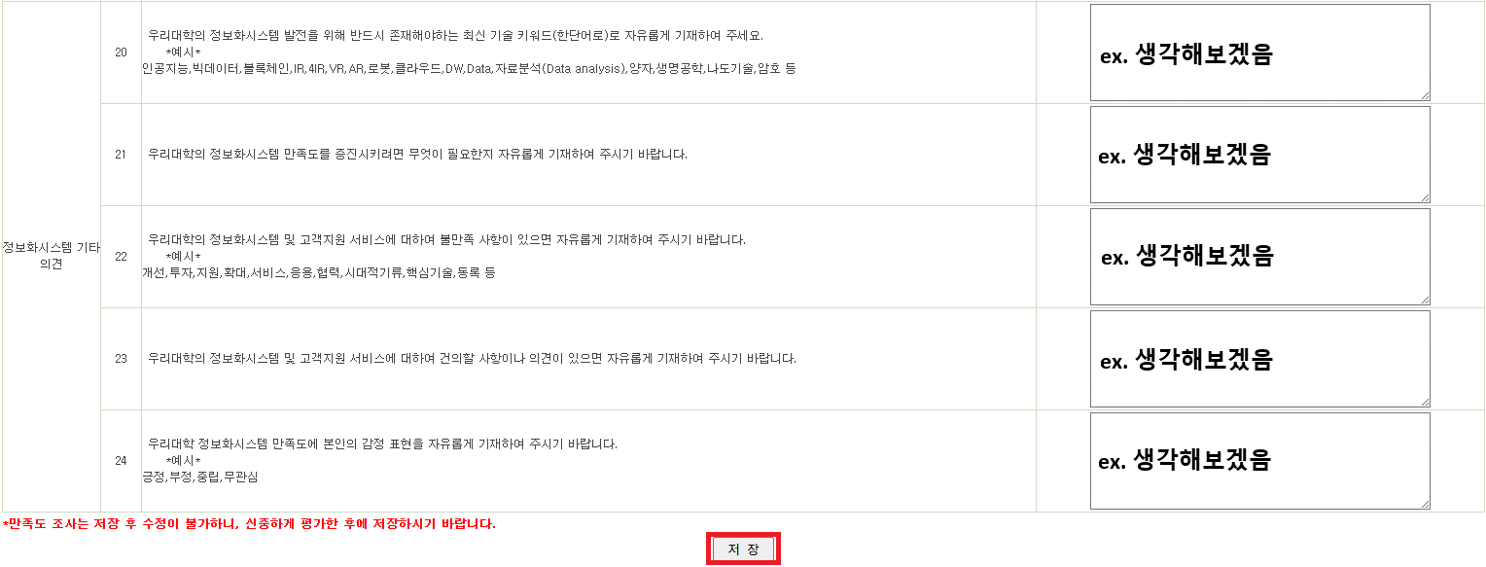
3-1. Please check the items exactly as shown in the photo below.
※ Make sure to click '저장'(SAVE) at the end.
How to Check International Students' Grades

Slide 14
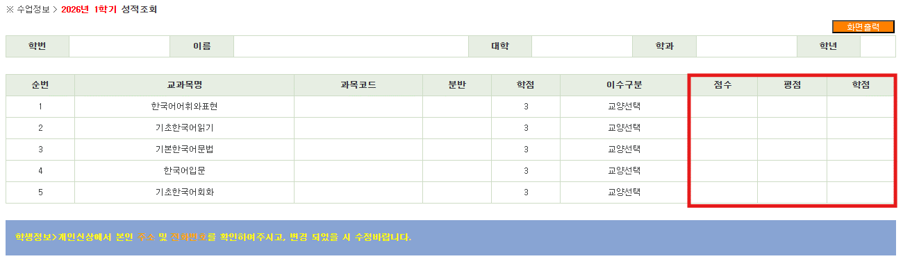
Once you complete all three surveys, your grades will appear like this.
How to Check International Students' Grades

